Slide 1

NASA SPACE APPS CHALLENGE 2024
TECH ELITES
TEAM MEMBERS
NIVETHA V
SHABANA FATHIMA S
PRAVEENA E
SNEHA SRI U
INDUJA K
JAYAPRIYA K

Slide 2
CHALLENGE
Leveraging Earth Observation Data for Informed Agricultural Decision-Making
IDEA SOLUTION:
Designing a tool that empowers farmers to easily explore, analyze, and utilize NASA datasets to address these water-related concerns and improve their farming practices.

Slide 3
UNIQUE VALUE PROPORTION
The unique value proposition of this tool is its ability to provide farmers with real-time, location-specific
insights by harnessing NASA’s vast Earth observation data, combined with AI-driven predictive analytics.
This empowers farmers to proactively manage water us age, mitigate risks from droughts and floods, and optimize crop health, leading to improved yields, reduced losses, and sustainable farming practices, all through an easy-to-use platform accessible on any device.
PROBLEM RESOLUTION
Integrate NASA's Earth observation data to monitor real-time weather, soil moisture, and crop health,
offering farmers accurate insights into droughts, floods, and pest outbreaks.
Use AI and predictive analytics to provide forecasts and risk alerts, enabling farmers to take preemptive actions like adjusting irrigation or applying pest control measures.

Slide 4
TECHNICAL APPROACH
1. Data Collection and Integration:
NASA Datasets: Utilize NASA’s Earth observation datasets (e.g., MODIS, Landsat, SMAP) via APIs to gather real-time weather, soil moisture, and crop health data.
External APIs: Integrate additional sources (e.g., local weather services, pest data) for more comprehensive insights.
2. Data Processing and Storage:
Backend: Build a backend system using Python (with libraries like pandas, geopandas) to preprocess and analyze data.
Database: Use PostgreSQL with PostGIS for spatial data storage, ensuring efficient querying of geographical and temporal data.
3. Machine Learning and Predictive Analytics:
AI Models: Implement machine learning models (e.g., decision trees, time-series models) for predicting weather patterns, pest risks, and water management suggestions.
Training Data: Use historical data from NASA and other sources to train models for accurate prediction of droughts, floods, and pest infestations.

Slide 5
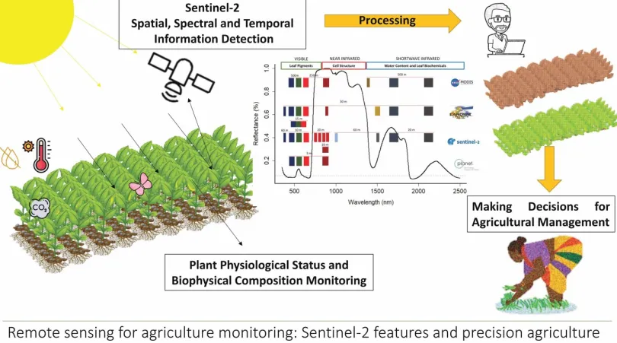
VISUAL REPRESENTATION

Slide 6
BENEFITS
Real-time Insights: Provides up-to-date information on weather, soil conditions, and crop health, helping farmers respond swiftly to environmental changes.
Risk Mitigation: AI-driven predictions and alerts allow farmers to proactively manage risks like droughts, floods, and pest outbreaks.
Informed Decision-Making: Personalized recommendations empower farmers to optimize water usage and improve crop management, leading to better yields and profitability.
Sustainability: Encourages sustainable farming practices by offering data-driven strategies to conserve resources and minimize losses.

Slide 7
REFERENCE AND LINKS
Leveraging Earth Observations in agriculture monitoring. Building a sustained capacity development model based on Remote Sensing in Eastern Africa
Nakalembe, C. L.;Becker-Reshef, I.;Dempewolf, J.;Ndungu, L. W.;Mwangi, K.
Monitoring Global Croplands with Coarse Resolution Earth Observations: The Global Agriculture Monitoring (GLAM) Project
Becker-Reshef, Inbal;Justice, Chris;Sullivan, Mark;Vermote, Eric;
From LACIE to GEOGLAM: Integrating Earth Observations into Operational Agricultural Monitoring Systems
Becker-Reshef, I.; Justice, C. O.

